Slide 1

Chapter 2. Probability
Weiqi Luo (骆伟祺)
School of Data & Computer Science
Sun Yat-Sen University
Email：luoweiqi@mail.sysu.edu.cn

Slide 2
What is probability?
Probability
The term probability refers to the study of randomness and uncertainty.
In any situation in which one of a number of possible outcomes may occur, the theory of probability provides methods for quantifying the changes, or likehoods, associated with the various outcomes.

Slide 3
Chapter two: Probability
2.1 Sample Spaces and Events
2.2 Axioms, Interpretations, and Properties of Probability
2.3 Counting Techniques
2.4 Conditional Probability
2.5 Independence

Slide 4
2.1 Sample Spaces and Events
Experiment
An experiment is any activity or process whose outcome is subject to uncertainty, e.g.
tossing a coin once or several times
selecting a card or cards from a deck, etc.
Sample Space
The sample space of an experiment, denoted by S , is the set of all possible outcomes of that experiment, e.g.
Examining whether a single fuse is defective or not. The two possible outcomes: D (defective) & N(not defective)
Two fuses in sequence: S ={DD DN ND NN}

Slide 5
2.1 Sample Spaces and Events
Example 2.3
Two gas stations are located at a certain intersection. Each one has six gas pumps. Consider the experiment in which the number of pumps in use at a particular time of day is determined for each of the stations. The possible outcomes:
 | 0 | 1 | 2 | 3 | 4 | 5 | 6
0 | (0 0) | (0 1) | (0 2) | (0 3) | (0 4) | (0 5) | (0 6)
1 | (1 0) | (1 1) | (1 2) | (1 3) | (1 4) | (1 5) | (1 6)
2 | (2 0) | (2 1) | (2 2) | (2 3) | (2 4) | (2 5) | (2 6)
3 | (3 0) | (3 1) | (3 2) | (3 3) | (3 4) | (3 5) | (3 6)
4 | (4 0) | (4 1) | (4 2) | (4 3) | (4 4) | (4 5) | (4 6)
5 | (5 0) | (5 1) | (5 2) | (5 3) | (5 4) | (5 5) | (5 6)
6 | (6 0) | (6 1) | (6 2) | (6 3) | (6 4) | (6 5) | (6 6)

Slide 6
2.1 Sample Spaces and Events
Example 2.4
If a new type-D flashlight battery has a voltage that is outside certain limits, that battery is characterized as a failure(F); otherwise, it is a success(S).
Suppose an experiment consists of testing each battery as it comes off an assembly line until we first observe a success. The sample space is
S= {S, FS, FFS, FFFS, …}
which contains an infinite number of possible outcomes.

Slide 7
2.1 Sample Spaces and Events
Event
An event is any collection (subset) of outcomes contained in the sample space S.
Simple Event
An event consists of exactly one outcome
Compound Event
An event consists of more than one outcome

Slide 8
2.1 Sample Spaces and Events
Example 2.5
Consider an experiment in which each of three vehicles taking a particular freeway exit turns left(L) or right(R) at the end of the exit ramp.
The 8 possible outcomes (simple events):
{LLL, RLL, LRL, LLR, LRR, RLR, RRL RRR }
Some compound events include
the event that exactly one of the three vehicles turns right : {RLL, LRL, LLR}
the event that all three vehicles turns in the same direction: {LLL, RRR}

Slide 9
2.1 Sample Spaces and Events
Example 2.6 (Ex.2.3 continued)
The event that the number of pumps in use is the same for both stations:
{(0,0),{1,1},{2,2},{3,3}, {4,4},{5,5},{6,6}}
The event that the total number of pumps in use is four
{(0,4), {1,3}, {2,2}, {3,1}, {4,0}}
The event that at most one pump is in use at each station
{(0,0),{0,1},{1,0},{1,1}}

Slide 10
2.1 Sample Spaces and Events
Example 2.7 (Ex. 2.4 continued)
the event that at most three batteries are examined:
{S, FS, FFS}
the event that an even number of batteries are examined
{FS, FFFS, FFFFFS, ...}

Slide 11
2.1 Sample Spaces and Events
An event is nothing but a set, so that relationships and results from elementary set theory can be used to study events. The following concepts from set theory will be used to construct new events from given events.
Union of two events A and B, denoted by A∪B, and read “A or B”, that is, all outcomes in at least one of the events A and B.
Intersection of two events A and B, denoted by A ∩ B and read A and B is the event consisting of all outcomes that are in both A and B.
Complement of an event A, denoted by A’, is the set of all outcomes in S that are no contained in A

Slide 12
2.1 Sample Spaces and Events
Example 2.8 (Ex. 2.3 continued)
For the experiment in which the number of pumps in use at a single six-pump gas station is observed.
Let A={0,1,2,3,4}, B={3,4,5,6} and C={1,3,5} . Then
A∪B = {0,1,2,3,4,5,6} = S ,
A∪C = {0,1,2,3,4,5}
A ∩ B= {3,4}
A ∩ C={1,3}
A’={5,6}
(A∪C)’={6}

Slide 13

2.1 Sample Spaces and Events
Mutually exclusive (disjoint) events
A and B have no outcomes in common, namely
Example
A = {Chevrolet, Pontiac, Buick}
B = {Ford, Merrcury}

Slide 14


2.1 Sample Spaces and Events
Venn Diagrams
S
S
S
A
B
A
A
B
A∩B
S
Universal set: the sample space S
Event : Subset of S
Element (object): Individual Outcome
A
B
Disjoint events

Slide 15
Homework
Ex. 2, Ex. 4, Ex. 9

Slide 16
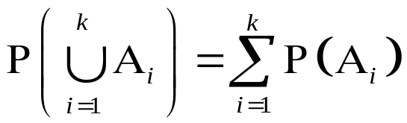
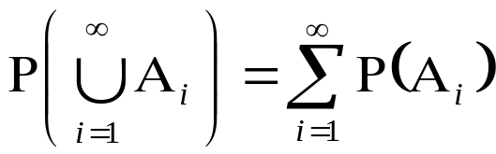
2.2 Axioms, Interpretations, and Properties of Probability
Given an experiment and a sample space S, the objective of probability is to assign to each event A a number P(A), called the probability of the event A, which will give a precise measure of the chance that A will occur. All assignments should satisfy the three following axioms of probability.
Axiom 1: for any event A, P(A)>=0
Axiom 2: P(S)=1
Axiom 3: if A₁,A₂, ..A_{k} (/…)is a finite / infinite collection of mutually exclusive events, then

Slide 17
2.2 Axioms, Interpretations, and Properties of Probability
Example
In the experiment in which a single coin is tossed, the sample space is S={H,T}. Then
P(S) = P(H) + P(T) = 1
since H ∪ T = S & H ∩ T = ф
Let P(H) = p, where p is any fixed number between 0 and 1, then P(T) = 1- p is an assignment consistent with the axioms.

Slide 18
2.2 Axioms, Interpretations, and Properties of Probability
Example 2.12 (Ex. 2.4 continued)
E₁={S}, E₂={FS}, E₃={FFS}, E₄={FFFS}…
Support the probability of any particular battery being satisfactory is 0.99, then
P(E₁) = 0.99
P(E₂) = 0.01×0.99
P(E₃) = (0.01)²×0.99 …
Note: S = E₁ ∪ E₂ ∪ E₃ ∪ E₄ ∪ …
and E_{i}∩E_{j} = ф (i is not j)
P(S) = 1 = P(E₁) + P(E₂) + P(E₃) +…

Slide 19
2.2 Axioms, Interpretations, and Properties of Probability
Two Special Events
Impossible event
The event contains no simple event
Certain event
The event contains all simple events
Suppose A is an impossible event and B is a certain event, then P(A)=0, P(B)=1
Q: P(A)=0 ➔ A is an impossible event ?
P(B)=1 ➔ B is a certain event ?

Slide 20
2.2 Axioms, Interpretations, and Properties of Probability
Interpreting Probability
Axioms #1-3 serve only to rule out assignments inconsistent with our intuitive notions of probability.
Methods for assigning appropriate/correct probability
1. Based on repeatedly experiments (objective), e.g. coin-tossing
2. Based on some reasonable assumption or prior information (subjective), e.g. a fair die
Note: May be different for different observers.

Slide 21
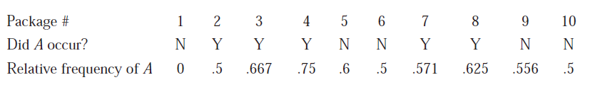
2.2 Axioms, Interpretations, and Properties of Probability
Consider an experiment that can be repeatedly performed in an identical and independent fashion, and let A be an event consisting of a fixed set of outcomes of the experiment.
If the experiment is performed n times, on some of the replications the event A will occur, and on others, A will not occur
Let n(A) denote the number of replications on which A does occur. Then the ratio is called the relative frequency of occurrence of the event A in the sequence of n replications.

Slide 22
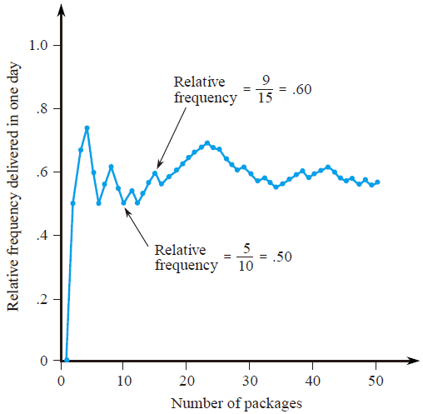
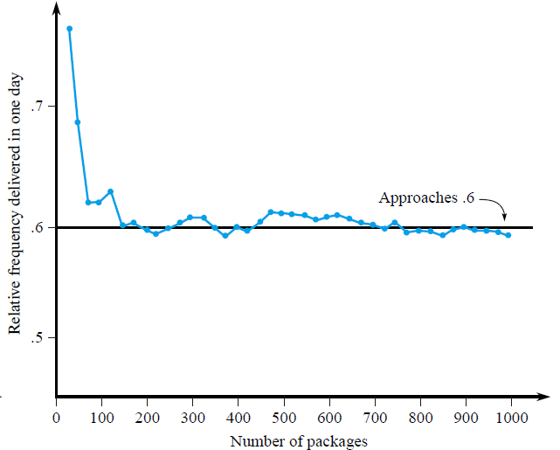
2.2 Axioms, Interpretations, and Properties of Probability
The objective interpretation of probability identifies this limiting relative frequency with P(A).

Slide 23
2.2 Axioms, Interpretations, and Properties of Probability
Property #1
For any event A, P(A)=1 - P(A’)
Proof:
By the definition of A’, we have
S = A ∪ A’ , A ∩ A’ = ф
Since
1=P(S) = P(A ∪ A’) = P(A) + P(A’)
then
P(A) = 1- P(A’)

Slide 24
2.2 Axioms, Interpretations, and Properties of Probability
Example 2.13
Consider a system of five identical components connected in series, as illustrated in the following figure
Denote a component that fails by F and one that doesn’t fail by S. Let A be the event that the system fails.
A={FSSSS, SFSSS, …} there are 31 different outcomes in A. However, A’ the event that the system works, consists of the single outcome SSSSS.
P(A) = 1- P(A’) = 1-0.9⁵=0.41
1
2
3
4
5

Slide 25
2.2 Axioms, Interpretations, and Properties of Probability
Property #2:
If A and B are mutually exclusive, then P(A ∩ B) =0
Proof:
Because A ∩ B contains no outcomes, (A ∩ B)’=S.
Thus we have that
P(S) = P[(A ∩ B)’] + P(A ∩ B) = P(S) + P(A ∩ B)
which implies
P(A ∩ B) =0

Slide 26


2.2 Axioms, Interpretations, and Properties of Probability
Property #3:
For any two events A and B,
P(A ∪ B) = P(A) + P(B) – P( A ∩ B)
=
+
A
B
A
B
B
A
A
A
Note: B= (B ∩ A’ ) ∪ (A ∩ B)
& (B ∩ A’ ) ∩ (A ∩ B) =ф
Proof:
P(A ∪ B) = P(A) + P(B ∩ A’)
= P(A) + [P(B) – P(A ∩B)]

Slide 27
2.2 Axioms, Interpretations, and Properties of Probability
Example 2.14
A = {gets Internet service}
B ={gets TV service}
P(A) = 0.6, P(B) = 0.8, P(A ∩ B) = 0.5
P(subscribes to at least one of the two services)
= P(A ∪ B) = P(A) + P(B) – P(A ∩ B) = 0.6+0.8-0.5=0.9
P(exactly one)
= P(A ∩ B’) + P(A’ ∩ B) =0.1+0.3 =0.4
Note: (A ∩ B’) + (A ∩ B) = A & (A ∩ B’) ∩ (A ∩ B) = ф
(A’ ∩ B) + (A ∩ B) = B & (A’ ∩ B) ∩ (A ∩ B) = ф

Slide 28
2.2 Axioms, Interpretations, and Properties of Probability
Determining Probabilities Systematically
When the number of possible outcomes (simple events) is large, there will be many compound events. A simple way to determine probabilities for these events is that
First determine probability P(E_{i}) for all simple events.
Note: P(E_{i})>=0 and ∑_{all i} P(E_{i})=1
The probability of any compound event A is computed by adding together the P(E_{i})’s for all E_{i}’s in A
P(A) = ∑_{all Ei’s in A} P(E_{i})
Note: Ei ∩ Ej = ф, i is not j

Slide 29
2.2 Axioms, Interpretations, and Properties of Probability
Example 2.15
Denote the six elementary events {1}, {2}, …{6} associated with tossing a six-sided die once by E₁,E₂,…E₆. If the die is constructed so that any of the three even outcomes is twice as likely to occur as any of the three odd outcomes (unfair die), then an appropriate assignment of probabilities to elementary events is P(E₁)=P(E₃)=P(E₅) = 1/9 and P(E₂)=P(E₄)=P(E₆)=2/9, then
the event A={outcome is even}= E₂ ∪E₄ ∪ E₆
P(A) = P(E₂)+P(E₄)+P(E₆)=2/3
the event B={outcome <=3}= E₁ ∪E₂ ∪ E₃
P(B) = P(E₁)+P(E₂)+P(E₃)=4/9

Slide 30
2.2 Axioms, Interpretations, and Properties of Probability
Equally Likely Outcomes
In many experiments consisting of N outcomes, it is reasonable to assign equal probabilities to all N simple events. e.g. tossing a fair coin or fair die, selecting cards from a well-shuffled deck of 52.
With p=P(E_{i}) for every i, then
1 = ∑_{i=1}^{N} P(E_{i} ) = ∑_{i=1}^{N} p ➔ p= 1/N
Consider an event A, with N(A) denoting the number of outcomes containing in A, then
P(A) = ∑_{Ei’s in A} P(E_{i}) = ∑_{Ei’s in A} 1/N = N(A)/N

Slide 31
2.2 Axioms, Interpretations, and Properties of Probability
Example
When two dice are rolled separately, there are N=36 outcomes. If both the dice are fair, all 36 outcomes are equally likely, so P(E_{i}) = 1/36. Then the event A={sum of two number =7} consists of the six outcomes (1,6) (2,5) (3,4), (4,3), (5,2) and (6,1), so
P(A) = N(A)/N = 6/36 = 1/6

Slide 32
Homework
Ex. 12, Ex. 17, Ex. 24, Ex. 27

Slide 33
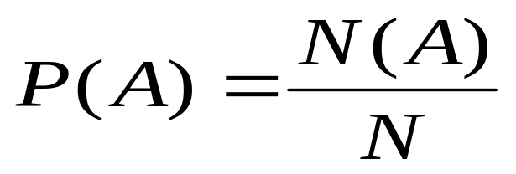
2.3 Counting Techniques
When the various outcomes of an experiment are equally likely, the task of computing probabilities reduces to counting. In particular, in N is the number of outcomes in a sample space and N(A) is the number of outcomes contained in an event A, then
Product Rule
Permutations
Combinations

Slide 34
2.3 Counting Techniques
Ordered Pair
By an ordered pair, we mean that, if O₁ and O₂ are different objects, then the pair (O₁,O₂) is different from the pair (O₂,O₁).
Counting the number of ordered pair
If the first element of object of an ordered pair can be selected in n₁ ways, and for each of these n₁ ways the second element of the pair can be selected in n₂ ways, then the number of pairs is n₁n₂

Slide 35
2.3 Counting Techniques
Example 2.17
A homeowner doing some remodeling requires the services of both a plumbing contractor and an electrical contractor. If there are 12 plumbing contractor P₁, P₂, …P₁₂ and 9 electrical contractors Q₁, Q₂, …, Q₉ available in the area, in how many ways can the contractors be chosen?
Task: counting the number of pairs of the form (P_{i}, Q_{j})
With n₁= 12, n₂=9, the produce rule yields N = 12×9=108
Note: In this example, the choice of the second element of the pair did not depend on which first element was chosen or occurred.
As long as there is the same number of choices of the second element for each first element, the product rule is valid even when the second elements depends on the first ones, see Ex. 2.18.

Slide 36
2.3 Counting Techniques
Example 2.18
A family has just moved to a new city and requires the services of both an obstetrician and a pediatrician. There are two easily accessible medical clinics, each having 2 obstetricians and 3 pediatricians. The family will obtain maximum health insurance benefits by joining a clinic and selecting both doctors from that clinic. In how many ways can this be done?
Denote the obstetricians by O₁,O₂,O₃, and O₄ and the pediatricians by P₁,…,P₆. Then we wish the number of pairs (O_{i}, P_{j}) for which O_{i} and P_{j} are associated with the same clinic. Because there are four obstetricians, n₁=4, and for each there are three choices of pediatrician, so n₂=3. Applying the product rule gives N= n₁ n₂=12 possible choices.

Slide 37
2.3 Counting Techniques
Tree Diagrams
P₁
P₂
P₃
O₁
Note: The construction of a tree diagram
does not depend on having the same
number of Second-generation braches
emanating from each First-generation
branch.
Thus a tree diagram can be used
to represent pictorially experiments other
than those to which the product rule
applies.
P₁
P₂
O₂
P₃
O₃
P₄
P₅
O₄
P₆
P₄
P₅
P₆

Slide 38
2.3 Counting Techniques
K-tuple
An ordered collection of k objects
Product Rule for k-Tuple
Support a set consists of ordered collections of k elements (k-tuples) and that there are n₁ possible choices for the first element; for each choice of the first element, there are n₂ possible choices of the second element; …, for each possible choice of the first k-1 elements, there are n_{k} choices of the k-th element. Then there are n₁n₂…n_{k} possible k-tuples.

Slide 39
2.3 Counting Techniques
Example 2.19 (Ex.2.17 continued)
Suppose the home remodeling job involves first purchasing several kitchen appliances. They will all be purchased from the same dealer, and there are five dealers in the area. With the dealers denoted by D₁, D₂, …D₅, there are N=n₁n₂n₃=5×12×9=540, 3-tuples of the form (D_{i},P_{j},Q_{k}), so there are 540 ways to choose first an appliance dealer, then a plumbing contractor, and finally an electrical contractor.

Slide 40
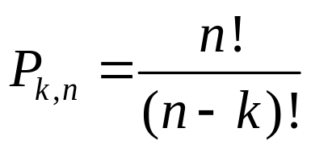
2.3 Counting Techniques
Permutation
Any ordered sequence of k objects taken from a set of n distinct objects is called a permutation of size k of the objects. The number of permutations of size k that can be constructed from the n objects is denoted by P_{k,n}.
P_{k,n} = n (n-1) (n-2) … (n-k+1)

Slide 41
2.3 Counting Techniques
Example 2.21
There are 10 teaching assistants available for grading papers in a particular course. The first exam consists of 4 questions, and the professor wishes to select a different assistant to grade each question (only one assistant per question). In how many ways can assistants be chosen to grade the exam?
Here
n = the number of assistants=10 &
k = the number of questions =4.
The number of different grading assignments is then
P_{k,n}=10×9×8×7=5040

Slide 42
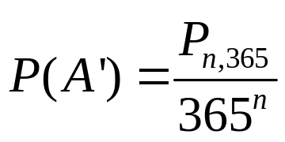
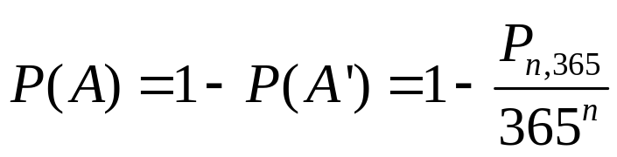
2.3 Counting Techniques
Birthday Paradox
In a set of n randomly chosen people (n is less than 366), what is the probability that some pair of them having the same birthday?
Let A={at least one pair of the n people having the same birthday}.
Then A’ = {all the n people have different birthday}.
n | 10 | 20 | 23 | 30 | 40 | 50
P(A) | 0.12 | 0.41 | 0.51 | 0.71 | 0.89 | 0.97

Slide 43
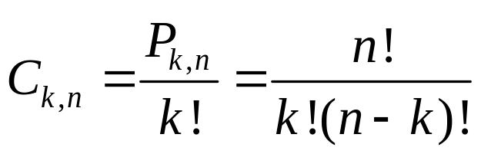
2.3 Counting Techniques
Combinations
Given a set of n distinct objects, any unordered subset of size k of the objects is called a combination. The number of combinations of size k that can be formed from the n distinct objects will be denoted by C_{k,n}
Note: the number of combinations of size k from a particular set is
smaller than the number of permutations because, when order is
disregarded, a number of permutations correspond to the same combination.

Slide 44
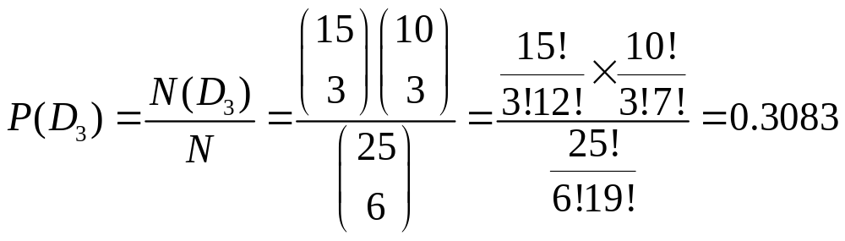
2.3 Counting Techniques
Example 2.23
A university warehouse has received a shipment of 25 printers, of which 10 are laser printer and 15 are inkjet models. If 6 of these 25 are selected at random to be checked by a particular technician, what is the probability that exactly 3 of those selected are laser printers?
Let D₃ ={exactly 3 of the 6 selected are inkjet printers}

Slide 45
Homework
Ex. 30, Ex. 39, Ex. 44

Slide 46
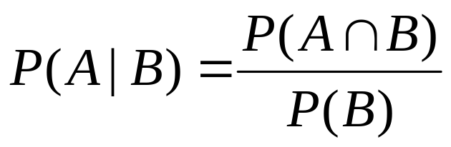
2.4 Conditional Probability
Definition of Conditional Probability
For any two events A and B with P(B)>0, the conditional probability of A given that B has occurred is defined by
Note:
1. Given that B has occurred, the relevant
sample space is no longer S but consists
of outcomes in B;
2. A has occurred if and only if one of the
outcomes in the intersection occurred.
S
A
B

Slide 47
2.4 Conditional Probability
Example 2.24
Complex components are assembled in a plant that uses two different assembly lines, A and A’. Line A uses older equipment than A’, so it is somewhat slower and less reliable. Suppose on a given day line A has assembled 8 components, of which 2 have been identified as defective (B) and 6 as nondefective (B’), whereas A’ has produced 1 defective and 9 nondefective components. This information is summarized in the accompanying table.
 |  | Condition
 |  | B | B’
Line | A | 2 | 6
 | A’ | 1 | 9

Slide 48
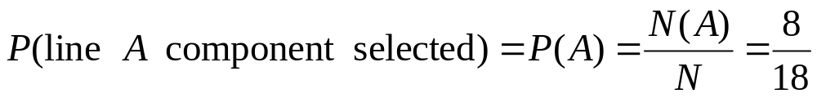
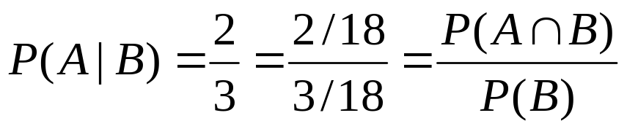
2.4 Conditional Probability
 |  | Condition
 |  | B | B’
Line | A | 2 | 6
 | A’ | 1 | 9
The sales manager randomly selects 1 of these 18 components for a demonstration. Prior to the demonstration
However, if the chosen component turns out to be defective, then the event B has occurred, so the component must have been 1 of the 3 in the B column of the table. Since these 3 components are equally likely among themselves after B has occurred,

Slide 49
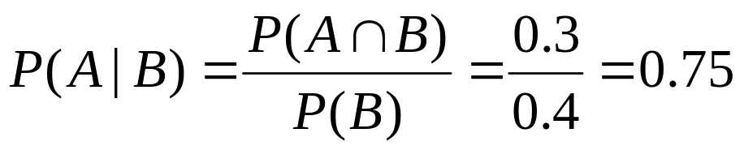
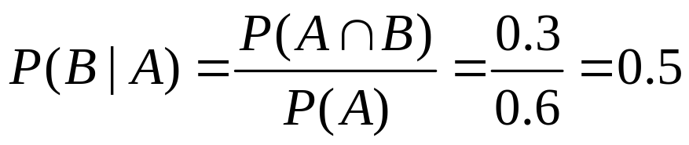

2.4 Conditional Probability
Example 2.25
Consider randomly selecting a buyer and let A={memory card purchased} and B={battery purchased}. Then P(A)=0.6, P(B)=0.4 and P(both purchased) = P(A∩B) = 0.3. Given that the selected individual purchased an extra battery, the probability that an optional card was also purchased is
That is, of all those purchasing an extra battery, 75% purchased an optional memory card. Similarly,

Slide 50
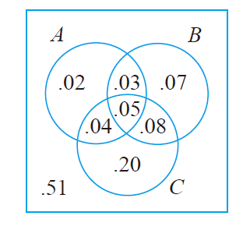
2.4 Conditional Probability
Example 2.26
A news magazine publishes three columns entitled “Art”(A), “Books”(B), and “Cinema”(C). Reading habits of a randomly selected reader with respect to these columns are
Read regularly | A | B | C | A∩B | A∩C | B∩C | A∩B∩C
Probability | 0.14 | 0.23 | 0.37 | 0.08 | 0.09 | 0.13 | 0.05
P(A|B) =0.348
P(A|B ∪C) =0.255
P(A|A ∪B∪C) =0.286
P(A ∪B|C) =0.459

Slide 51
2.4 Conditional Probability
The Multiplication Rule
P(A∩B) = P(A | B) P(B)
This rule is important because it is often the case that P(A∩B) is desired, whereas that both P(B) and P(A|B) can be specified from the problem description.
Note :
1. P(A∩B) = P(A | B) P(B) =P(B | A) P(A)
2. P(A₁∩A₂ ∩A₃) = P(A₃ |A₁ ∩A₂) P(A₁ ∩A₂)
= P(A₃ |A₁ ∩A₂) P(A₂ |A₁) P(A₁)

Slide 52
2.4 Conditional Probability
Example 2.27
Four individuals have responded to request by a blood bank for blood donations. None of them has donated before, so their blood types are unknown. Suppose only type O+ is desired and only one of the four actually has this type. If the potential donors are selected in random order for typing, what is the probability that at least three individuals must be typed to obtain the desired type?
Let B={first type not O+}, A = {second type not O+}
P(at least three individuals must be typed) = P(A∩B)
we know that P(B) = 3/4 and P( A | B ) = 2/3 (why?)
Based on The Multiplication Rule, we have
P(A∩B) = P( A | B ) P(B) = 0.5

Slide 53
2.4 Conditional Probability
Example 2.28
For the blood typing experiment of Example 2.27,
P(third type is O+)
= P(third is ∩ first isn’t ∩ second isn’t)
= P(third is | first isn’t ∩ second isn’t) P(first isn’t ∩ second isn’t)
= P(third is | first isn’t ∩ second isn’t) P(second isn’t | first isn’t) P(first isn’t)
= 1/2 × 2/3 × 3/4 = 0.25

Slide 54
2.4 Conditional Probability
Example 2.29
A chain of video stores sells three different brands of VCRs. Of its VCR sales, 50% are brand 1, 30% are brand 2, and 20% are brand 3. Each manufacturer offers a 1-year warranty on parts and labor. It is known that 25% of brand 1’s VCRs require warranty repair work, whereas the corresponding percentages for brands 2 and 3 are 20% and 10%, respectively.
1. What is the probability that a randomly selected purchaser has bought a brand 1 VCR that will need repair while under warranty?
2. What is the probability that a randomly selected purchaser has a VCR that will need repair while under warranty?
3. If a customer returns to the store with a VCR that needs warranty repair work, what is the probability that it is a brand 1 VCR? A brand 2 VCR? A brand 3 VCR?

Slide 55
2.4 Conditional Probability
Example 2.29 (Cont’)
First Stage:
a customer selecting one of the three brands of VCR
Let P(A_{i}) = {brand i is purchased}, where i= 1, 2, 3
then P(A₁) = 0.5, P(A₂) = 0.3, P(A₃) = 0.2
Second Stage:
observing whether the selected VCR needs warranty repair
Let B = {needs repair} B’={doesn’t need repair}
then P(B|A₁) =0.25, P(B|A₂) =0.20, P(B|A₃) =0.10

Slide 56
2.4 Conditional Probability
Example 2.29 (Cont’)
Q1
P(B|A₁)=0.25
P(A₁ ∩ B )= P(A₁) P(B|A₁)= 0.125
Repair
P(B’|A₁)=0.75
P(A₁)=0.5
No Repair
Brand 1
P(B|A₂)=0.2
P(A₂ ∩ B )= P(A₂) P(B|A₂)= 0.06
P(A₂)=0.3
Repair
Brand 2
P(B’|A₂)=0.8
No Repair
Brand 3
P(A₃)=0.2
P(B|A₃)=0.1
P(A₃ ∩ B )= P(A₃) P(B|A₃)= 0.02
Repair
No Repair
Q2
P(B’|A₃)=0.9
P(B) = 0.125+0.06+0.02=0.205

Slide 57
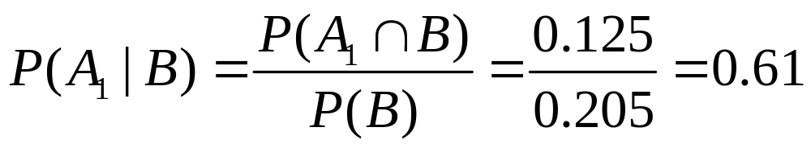
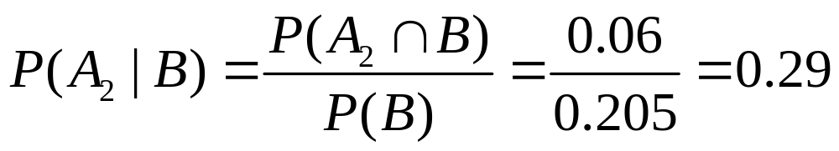
2.4 Conditional Probability
Example 2.29 (Cont’)
Q3

Slide 58
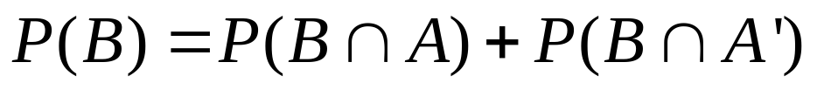
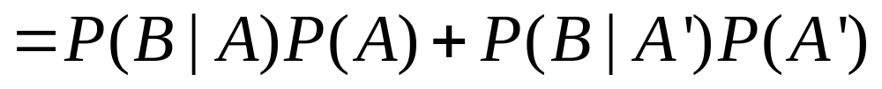
2.4 Conditional Probability
The Law of Total Probability (2-D case)
A
A’
Note:
A U A’ =S
A ∩ A’ = ф
B
B ∩ A
B ∩ A’
S

Slide 59
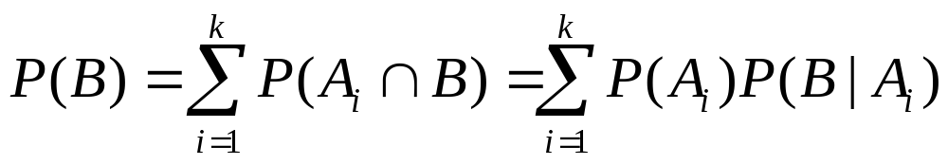
2.4 Conditional Probability
The Law of Total Probability (general cases)
Let A₁, …A_{k} be mutually exclusive and exhaustive events (Partition of S). Then for any other event B
A₂
A_{k}
A₁
B
…
S
A₃
A₄

Slide 60
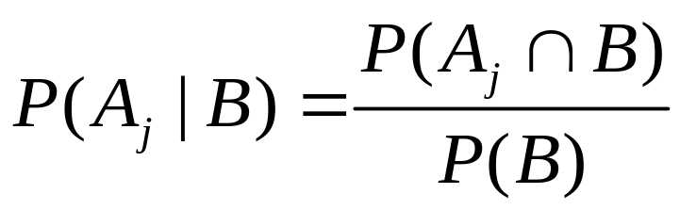
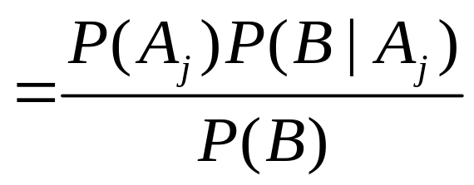
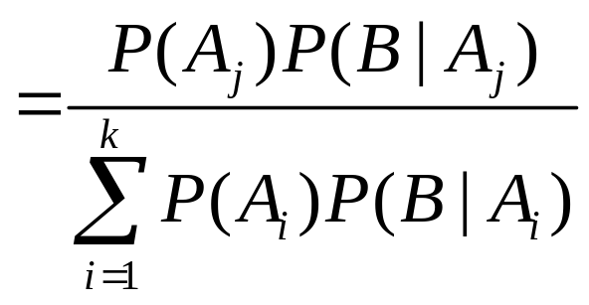

2.4 Conditional Probability
Bayes’ Theorem
Let A₁,A₂,…A_{k} be a collection of k multually exclusive and exhaustive events with P(A )>0 for i=1,…k, then for any other event B for which P(B)>0.

Slide 61
2.4 Conditional Probability
Example 2.31
Incidence of a rare disease. Only 1 in 1000 adults is afflicted with a rare disease for which a diagnostic test has been developed. The test is such that when an individual actually has the disease, a positive result will occur 99% of the time, whereas an individual without the disease will show a positive test result only 2% of the time. If a randomly selected individual is tested and the result is positive, what is the probability that the individual has the disease?
Let: A₁={individual has the disease} A₂={individual does not have the disease}, and B ={positive test result}. Then P(A₁)=0.001; P(A₂)=0.999, P(B|A₁)=0.99 and P(B|A₂)=0.02.

Slide 62


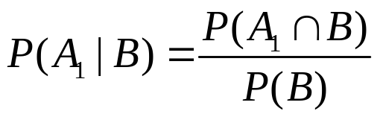
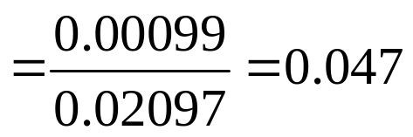
2.4 Conditional Probability
Example 2.30 Cont’
0.99
B=+Test
0.001
0.01
A1=has disease
B=-Test
0.999
0.02
B=+Test
A2=doesn’t have disease
0.98
B=-Test
P(B) = P(A₁∩B) + P(A₂∩B) =0.2097

Slide 63
2.4 Conditional Probability
Homework
Ex. 45, Ex. 50, Ex. 58, Ex. 66

Slide 64
2.5 Independence
Definition
Two events A and B are independence if P(A | B)=P(A) and are dependent otherwise.
Note:
Since P(A∩B) = P(A | B)P(B) = P(B | A)P(A)
if P(A | B)=P(A), then we have
P(A) P(B) = P(B|A)P(A) ➔ P(B|A) = P(B) (if P(A) >0)
If A and B are independence, so are the following pairs of events:
a. A’ and B b. A and B’ c. A’ and B’

Slide 65
2.5 Independence
Example
Consider tossing a fair six-sided die once and define events A={2,4,6}, B={1,2,3}, and C={1,2,3,4}. We then have P(A)=1/2, P(A | B)=1/3 and P(A | C)=1/2. That is, events A and B are dependent, whereas events A and C are independent.
Note: Intuitively, if such a die is tossed and we are informed that the outcome was 1,2,3,or 4 (C has occurred), then the probability that A occurred is 1/2, as it originally was, since two of the four relevant outcomes are even and the outcomes are still equally likely.

Slide 66
2.5 Independence
Example 2.33
Let A and B be any two mutually exclusive events with P(A)>0. For example, for a randomly chosen automobile, let A={the car has four cylinders} and B={the car has six cylinders}.
Since the events are mutually exclusive, if B occurs, then A cannot possibly have occurred, so P(A|B) =0 ≠ P(A). The message here is that if two events are mutually exclusive, they cannot be independent.
(Here: P(A) & P(B) are not zero!)

Slide 67
2.5 Independence
Proposition #1
A and B are independent if and only if
P(A∩B) = P(A) P(B)
Proof:
1. If A and B are independent, then
P(A|B) = P(A) , and thus
P(A∩B) = P(A|B)P(B) = P(A) P(B)
2. If P(A∩B) = P(A) P(B), then
P(A∩B) = P(A|B)P(B) = P(A) P(B)
P(A|B) = P(A) (P(B)>0), A and B are independent

Slide 68
2.5 Independence
Example 2.34
It is known that 30% of a certain company’s washing machines require service while under warranty, whereas only 10% of its dryers need such service. If someone purchases both a washer and a dryer made by this company, what is the probability that both machines need warranty service?
Let A be the event that washer needs service while under warranty, and B be defined analogously for the dryer, then P(A) = 0.3, P(B) = 0.1. Assuming that the two machines function independently of one another, the desired probability is
P(A∩B) = P(A) P(B) =0.3×0.1=0.03.
The probability that neither machine needs service is
P(A’ ∩B’) =P(A’) P(B’) = (1-0.3) (1-0.1)=0.63

Slide 69
2.5 Independence
Example 2.35
0.8
passes
0.2
fails
0.4×0.8×0.9
0.6
0.9
1 batch
2nd passes
0. 1
2nd fails
0.4
0.8
1st passes
2 batches
0.2
0.9
2nd passes
1st fails
0. 1
2nd fails

Slide 70
2.5 Independence
Mutually Independent
Events A₁, A₂, …A_{n} are mutually independent if for every k (k=2,3…n) and every subset of indices i₁,i₂…i_{k}
P(A_{i1} ∩A_{i2}… ∩Ai_{k}) = P(A_{i1})P(A_{i2})…P(A_{ik})

Slide 71
2.5 Independence
Example 2.36
1
2
3
1
2
3
4
5
6
4
5
6
System-1
System-2
P(system-1 lifetime exceeds t0)
=P[(A₁ ∩ A₂ ∩ A₃ )∪ (A₄ ∩ A₅ ∩ A₆)]
=P(A₁ ∩ A₂ ∩ A₃ ) +P(A₄ ∩ A₅ ∩ A₆)-P(A₁ ∩ A₂ ∩ A₃ ∩ A₄ ∩ A₅ ∩ A₆)
=0.9³+0.9³-0.9⁶=0.927
P(system-2 lifetime exceeds t0)
=P[(A₁ ∪ A₄) ∩(A₂ ∪ A₅) ∩(A₂ ∪ A₅)]
= P(A₁ ∪ A₄)³
=[P(A₁)+P(A₄) – P(A₁ ∩ A₄)]³
=[P(A₁)+P(A₄) – P(A₁)P(A₄)]³
=(0.9+0.9-0.9×0.9)³=0.97

Slide 72
2.5 Independence
Homework
Ex. 72, Ex. 78, Ex. 82, Ex. 87

